Slide 1
Azure, Deep Learning & Intelligent Robots
David Crook
@Data4Bots
www.DaCrook.com

Slide 2
Expectations
Provide Guidance and Understanding
Open Q&A
What is a Robot
Life Cycle
Impact and Effectiveness
Focused on practicality
From the perspective of making it work
Notes:
Forming data into a fashion that delivers particular insights.
These can be numerical or to push into a format to drive charts or portions of charts.

Slide 3
Important to Know
Microsoft Azure
IaaS: Virtual Machines, Networking, Storage, Containers etc.
PaaS: Communications, Machine Learning, Web, Streaming etc.
SaaS: Office, Email, Skype, Chat etc.
Deep Learning
Caffe: From Berkley Vision Center.
Networks: Image Classification, Object Detection, Pattern Matching, Generation etc.
Digits: No need for a PhD; effective common algorithms on GPU out of the box
Robotics
Brains: TX-1, Raspberry Pi. High order embedded controllers.
Control Hubs: Arduinos, PICs. Low order real time embedded controllers.
Actuary: Servos, DC Motors, Stepper Motors etc. Moving Parts
Sensory: Cameras, Gyroscopes, Infrared, Distance etc. Senses the world around it.

Slide 4

What is a Robot?
Decisions
Sensors
Judgement + Memory
World inputs such as cameras
Controls
Actuators
Signals to maintain sensors
and actuators
Things that move.

Slide 5
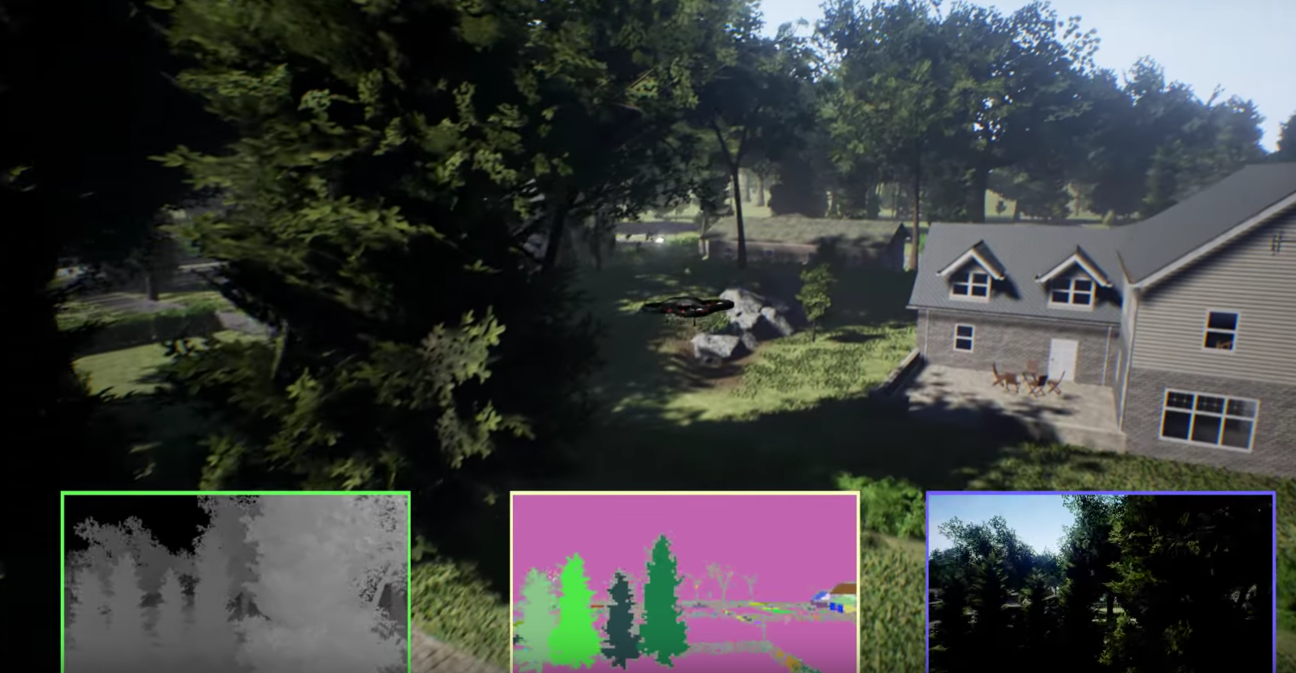
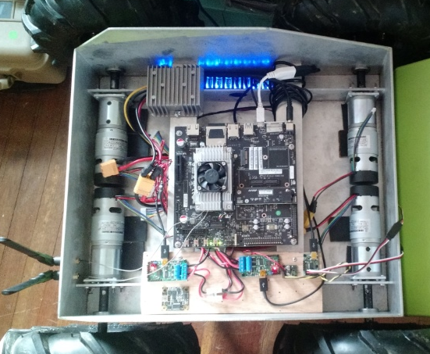
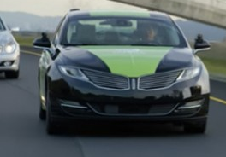
Intelligent Robot Lifecycle
Simulate
Work through A.I. and hardware quickly in a pre-prototype phase. Produces a ton of data. Record simulated telemetry streams for development of necessary models.
Prototype
Physical application of simulation. Produces more data. Work data in with simulated data to fine tune algorithms for the real world. Continually push these boundaries with the physical prototype.
Produce
Produce a real product for broad distribution. There will still be data collected for fine tuning. This data will help adjunct the previous data as well as design simulations as a further test bed.

Slide 6

The Robot Data Life Cycle
experiences
intelligence
repeat
Notes:
Experiences are the raw telemetry data we get from the robot
Intelligence is the improved models we develop based on the data collected from the robot.
We repeat as the robots will continue to have more experiences.

Slide 7
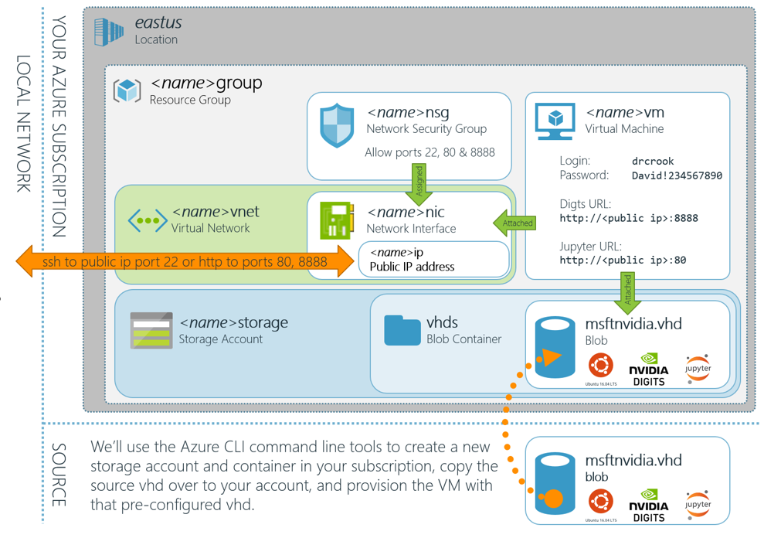
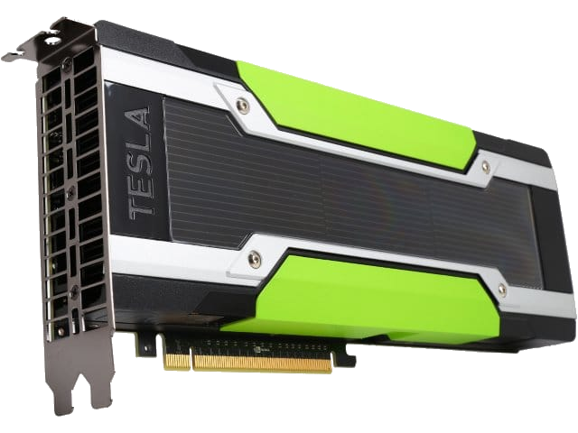
Azure Transforms Experiences into Intelligence

Slide 8
The Robot Data Life Cycle (Review it again)
experiences
intelligence
repeat
Notes:
Experiences are the raw telemetry data we get from the robot
Intelligence is the improved models we develop based on the data collected from the robot.
We repeat as the robots will continue to have more experiences.

Slide 9
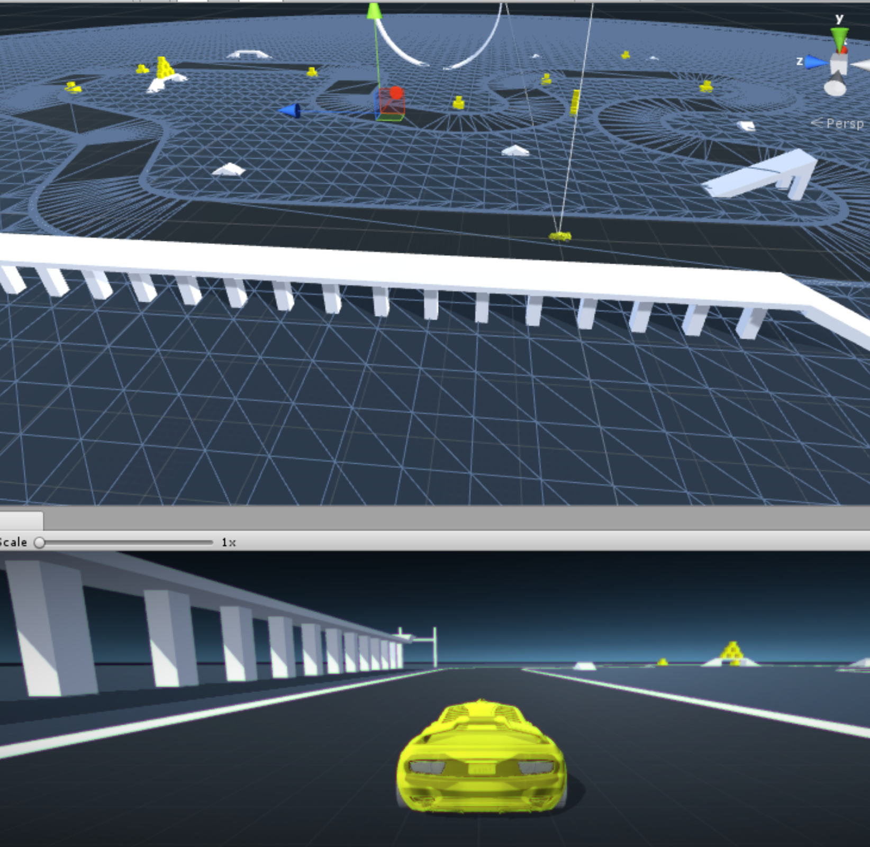
Simulation
Headless in Azure
AI Training Clusters Learn Basics in Simulator
Merge results from thousands of simultaneous learners
Dump Results/History to Data Lake
Iterate AI quickly/easily

Slide 10
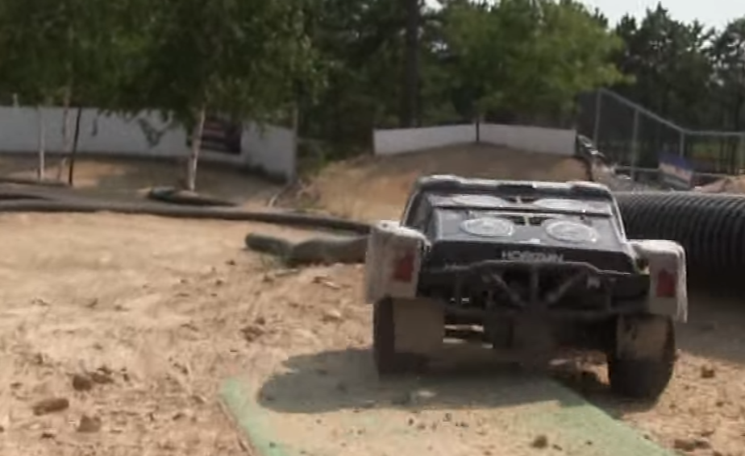
Train on Race Track
Tune on Race Track
Start with model trained on simulated data
Learn more on track
Blob Storage
Batch Dumps
IoT Hub
Diagnostics Ingestion
Push commands
Manual Override

Slide 11
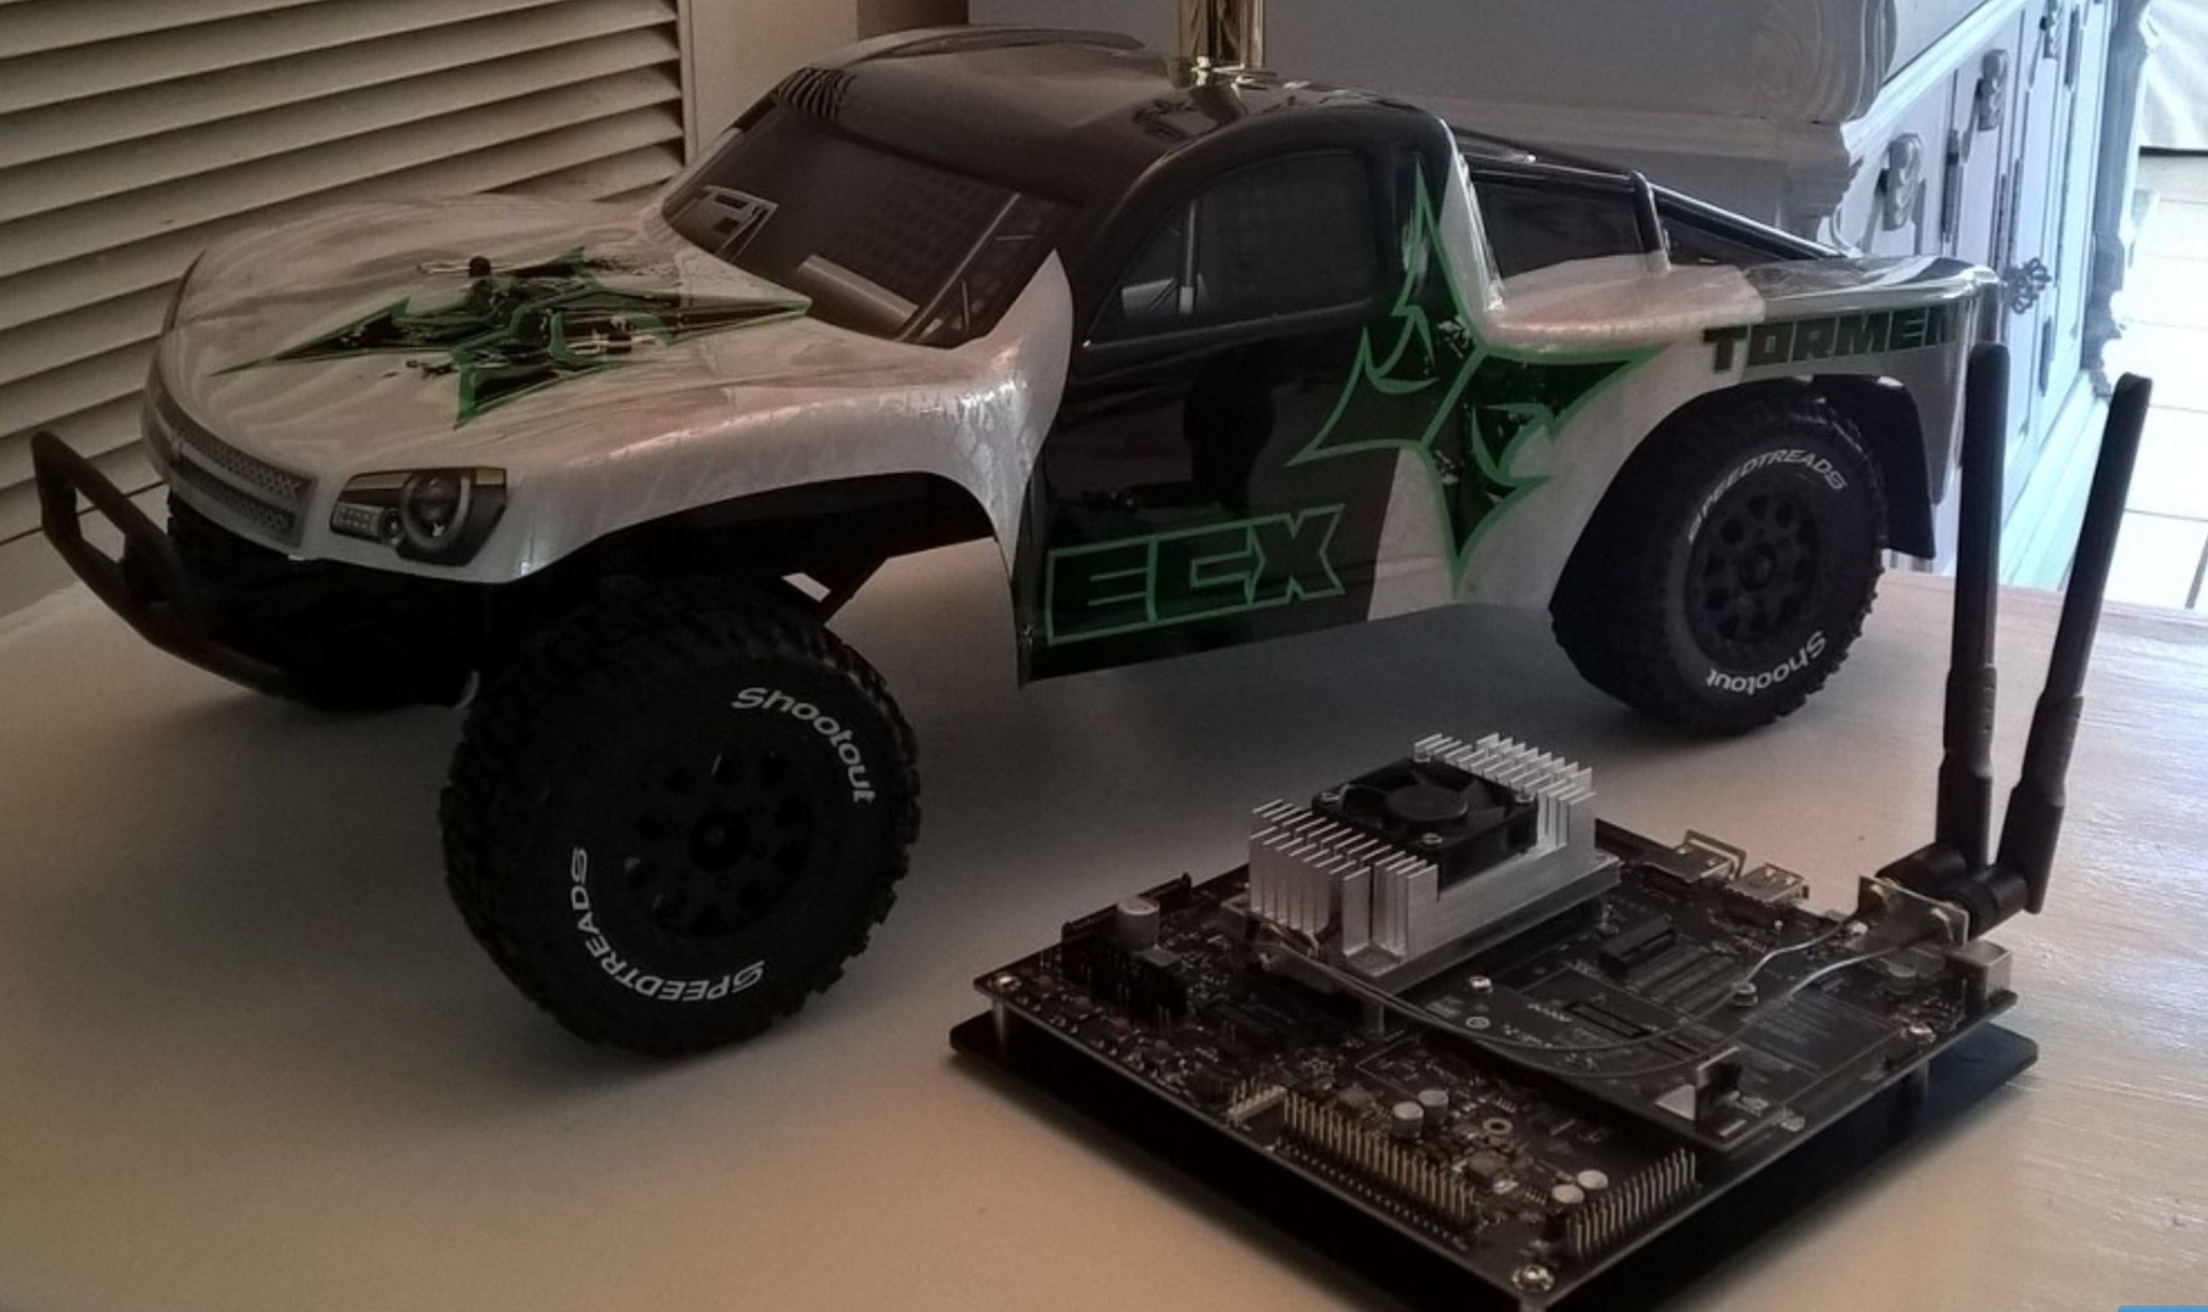
Summary of Self Driving Race Car
Hardware Components
ECX Torment (~35 mph)
Nvidia TX-1 + Camera + Comms
Azure Platform
IoT Hub
Azure Data Lake
GPU VMs
App Services
Media Services
Azure Batch
Docker

Slide 12
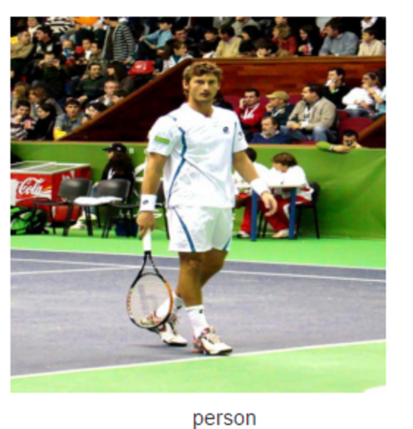
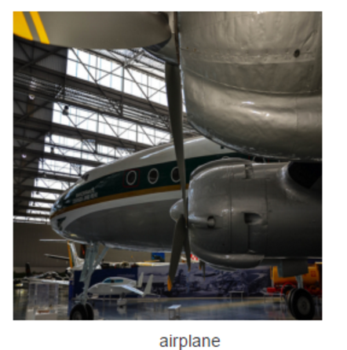
Image Classification Review
What is deep learning?
Why convolutional networks?
Discussion Points

Slide 13
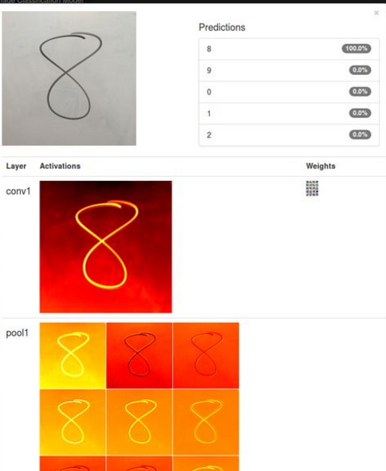
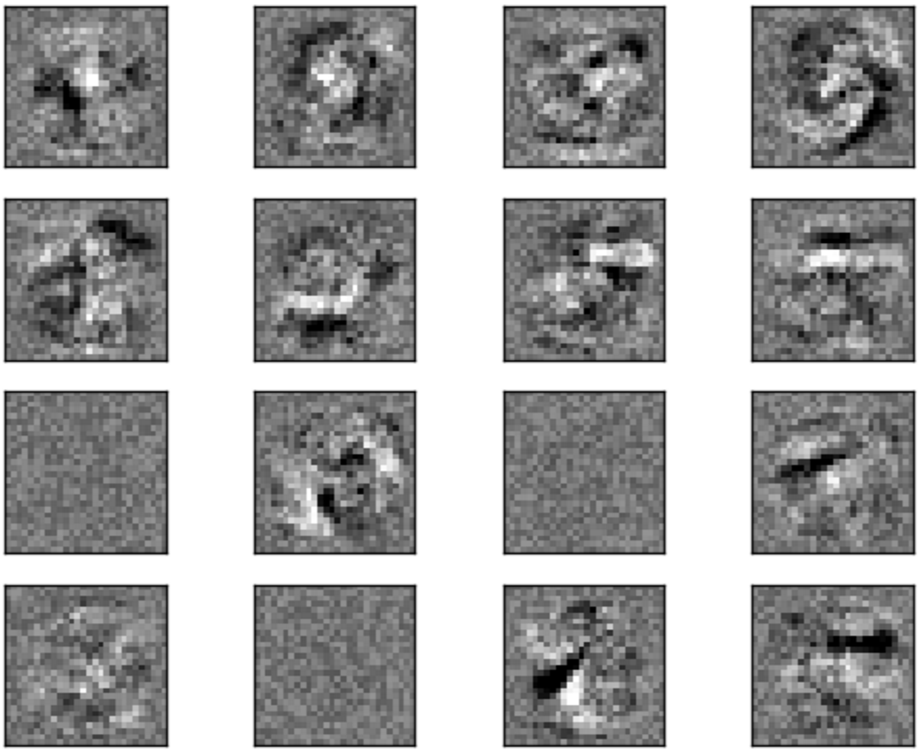
Weights and Activations

Slide 14
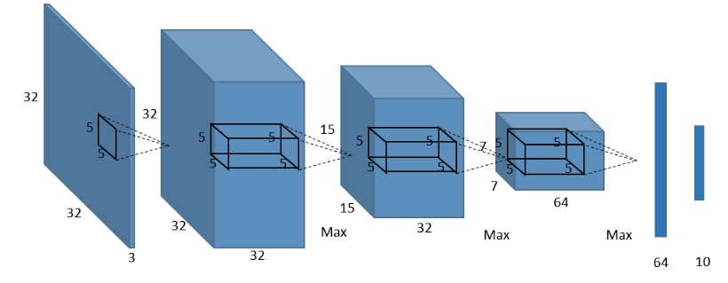
Deep Learning – Convolutional Networks
Predict 10 classes
Reduced features to most
Important representations
32x32 RGB Image input
64 5x5 features created
Flatten and mix
(normal network)
32 5x5 features created
Notes:
If attendee asks: “How did we go from 15x15 to 7x7 -> Because there is another max pooling layer in the middle which reduces the features to the most important representations just like from the 32x32 did to the 15x15.
It is an RGB image, because it is 32x32x3 (the 3 is Red Green Blue)
Important Notes:
1. Convolutional Networks takes into account localized patterns and reduces computation through pooling and is therefor faster and more accurate than traditional fully connected networks.
2. Digits makes it so you don’t actually need to know this stuff to get good results.

Slide 15
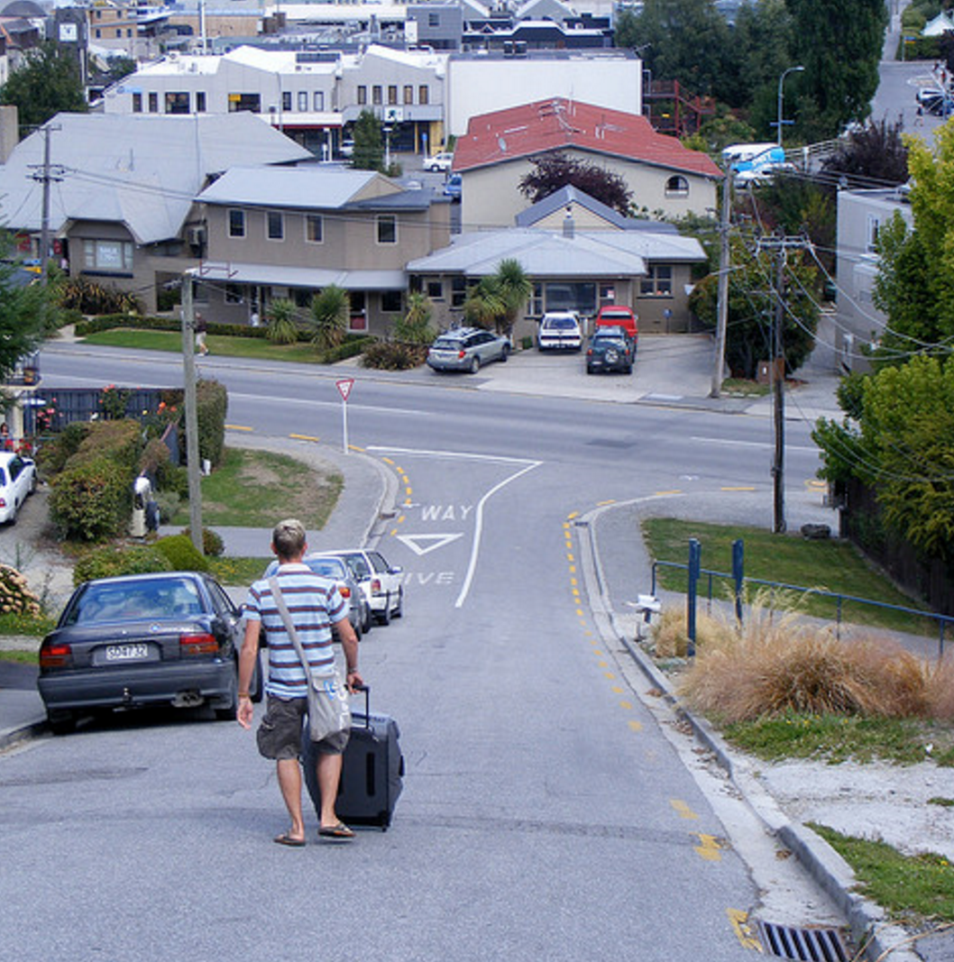
What do you do about this?
Can’t use Image Classification
Discussion on why it fails

Slide 16
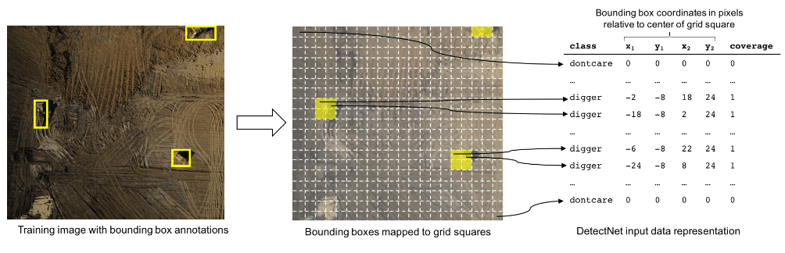
Object Detection Review
Make sure folks used right settings.
Review Label File Formats and Questions
How it works
Basically sliding a box over the image classifying things.
Grab the location of the box
Merge Boxes together
Who cares? Its out of the box with Digits!

Slide 17
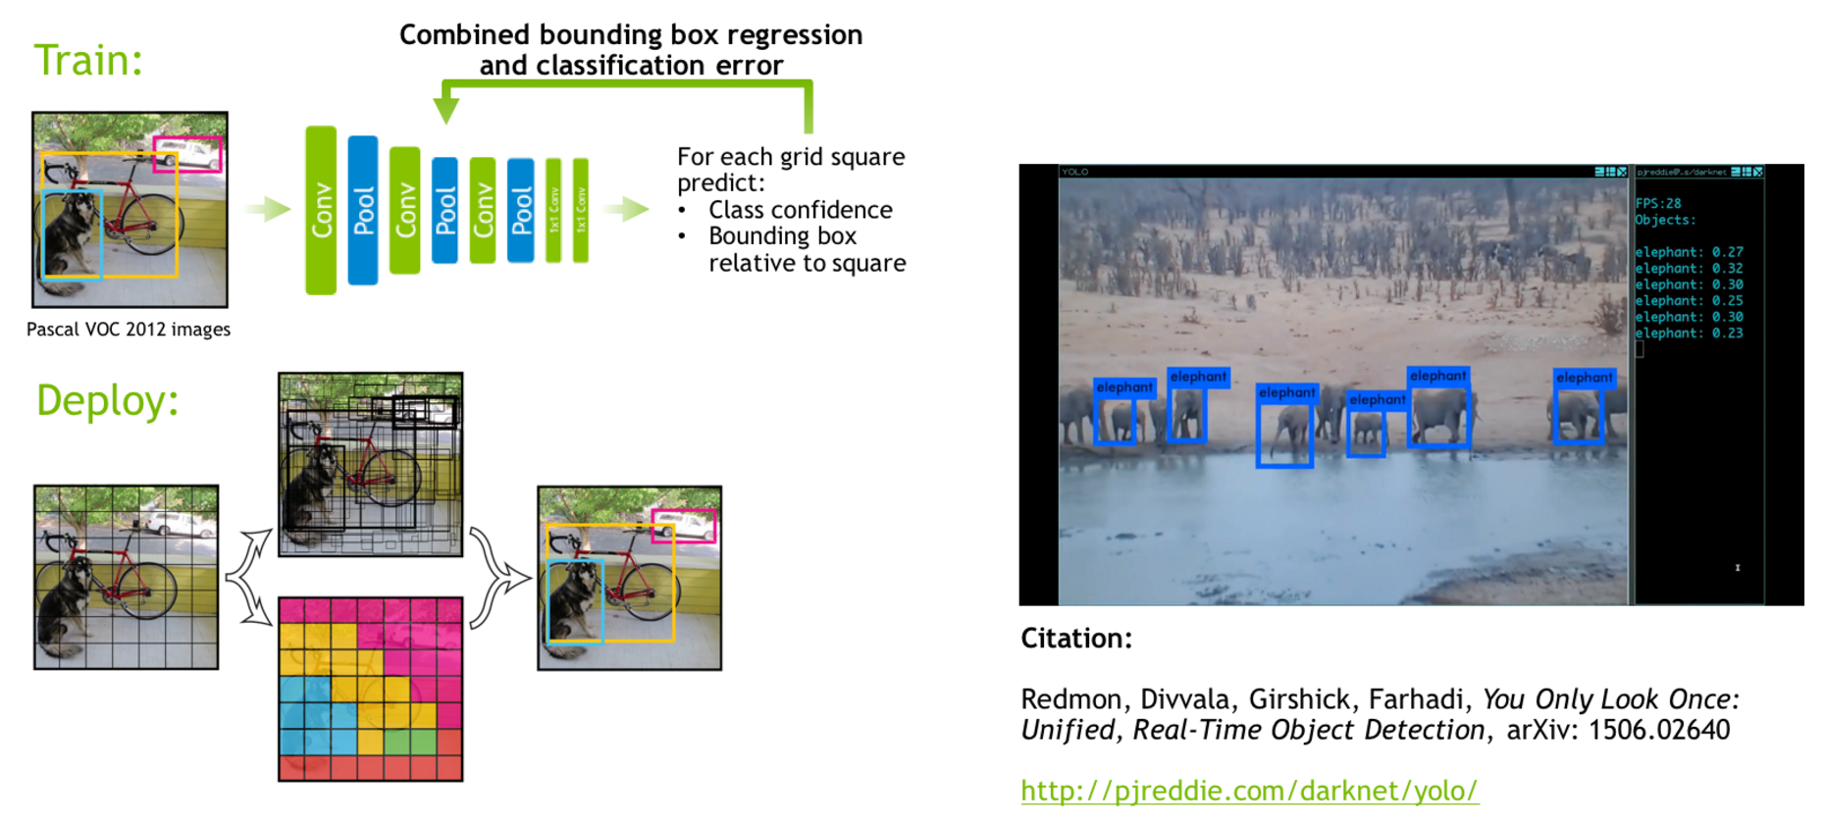
Detect Net (Digits Object Detection)

Slide 18
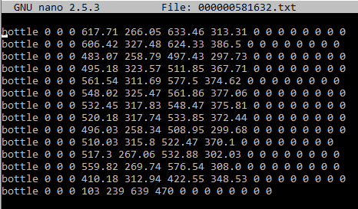
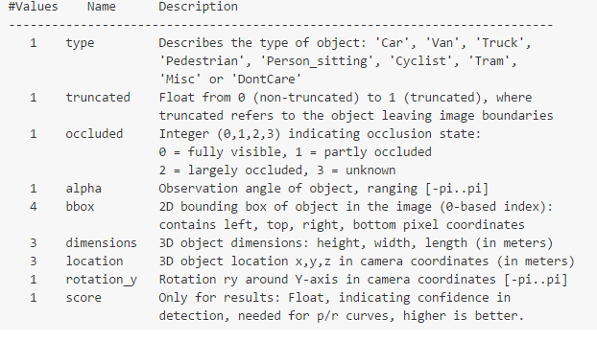
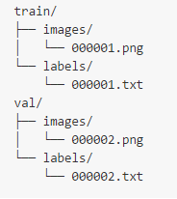
Use Your Data - Label Files
https://github.com/tzutalin/labelImg
Generates XML in wrong format
Works great though
Write Code
Get it into right format
Place into correct folders
Watch Digits work.
Notes:
Digits uses the Kitti format which is built for the Berkley CV center; so many labels are not used in object detection, but rather in more advanced scenarios.

Slide 19
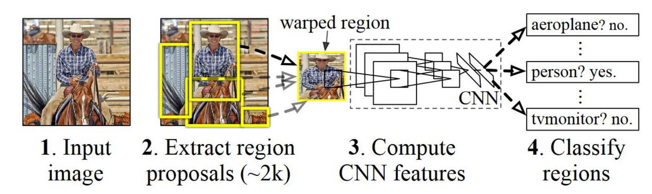
Object Detection Alternate Methods
Known Finite per image
Good for certain scenarios, not others
Fast RCNN
Cluster
Predict
Merge

Slide 20
A Little More Wild West
Azure Batch
Batch Processing Scheduling & Control
Azure Ship Yard
Dockerized Batch Processing
Azure Data Lake
Infinite data storage optimized for big data workloads
HDFS Compliant as well.
Whatever workload you want
Tensor Flow, CNTK, Caffe, Other
Linux, Windows
ML, Data Science, Simulation

Slide 21
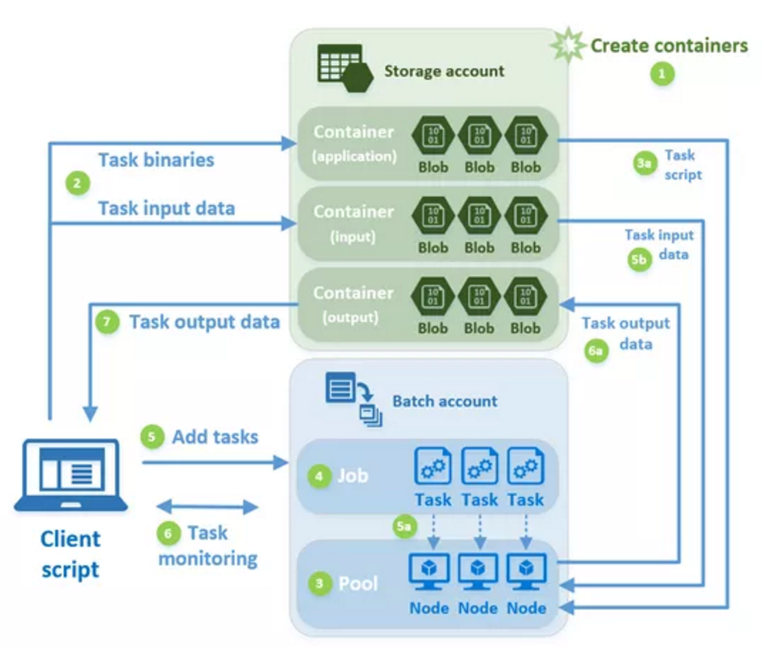

Slide 22
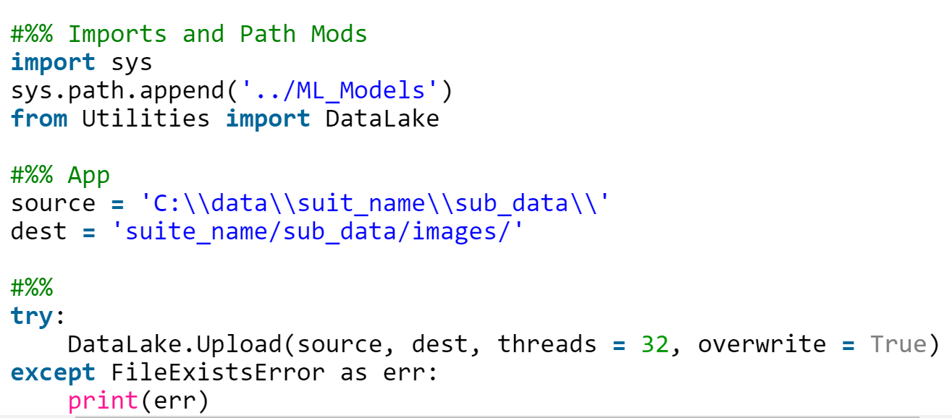
Ingestion

Slide 23
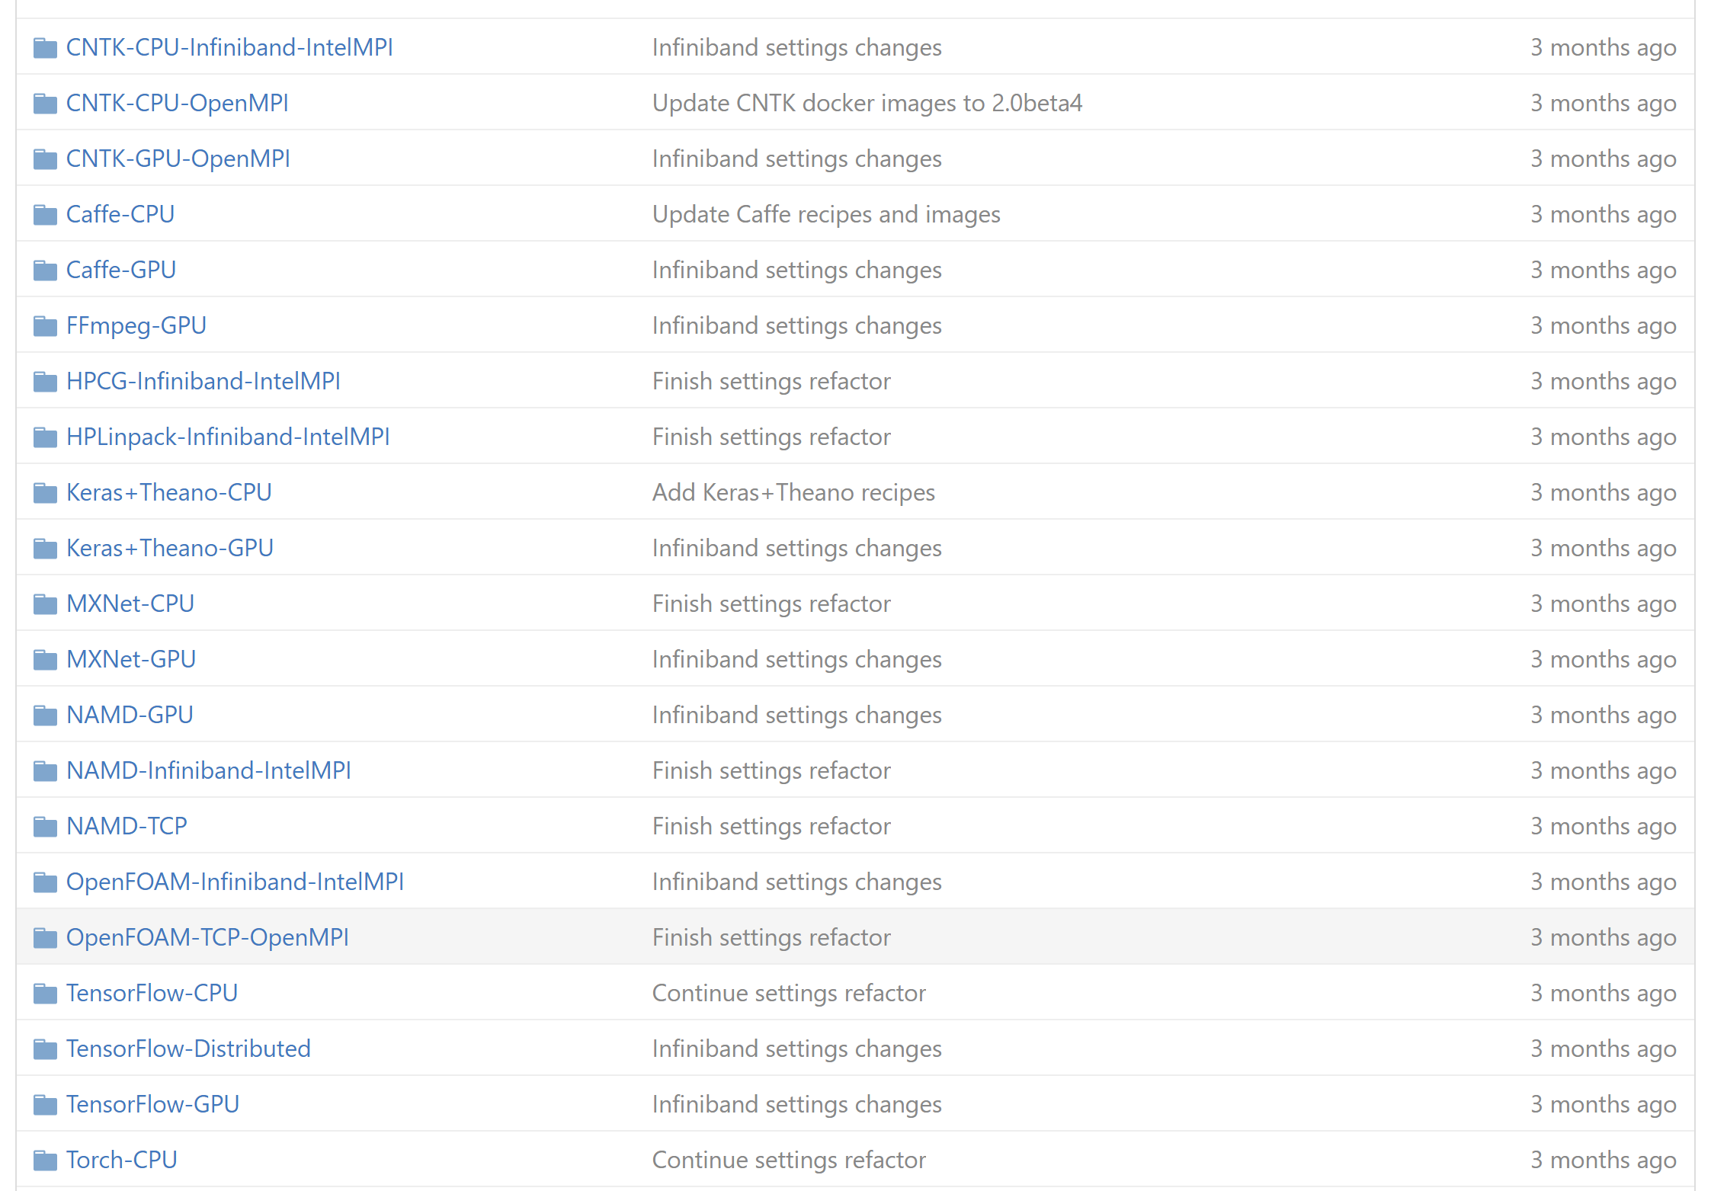
Usage

Slide 24
Cost Comparison – Robo Labs Case Study
GPU Work Station - $6,000
5 Engineers * $6k = $30,000
Azure Batch + Data Lake
$3/hour per vm
20 hours per cv algorithm
$60 per algorithm.
~$25,000 Savings over workstations

Slide 25
Collaboration
Centralized Data
Shared Generated Data
Shared Generated Labels
Shared Compute
Pay for what you use
Pay for algorithms, not machines
Parallel Workloads
Engineers can work simultaneously
Use same source data for different workloads
More effective Teams

Slide 26
Open Q&A

Slide 27
@Data4Bots
www.dacrook.com

